Slide 1


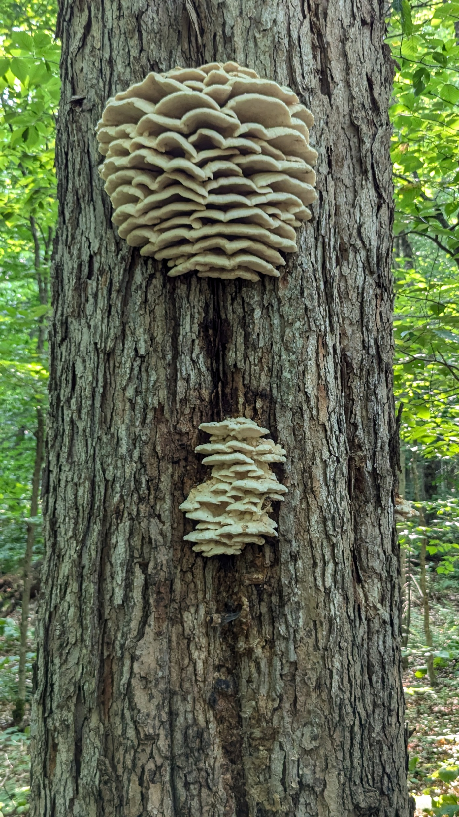
Week 3 -- September 16
CISC-6100:
Software Engineering
Finishing up user requirements
Tasks, high-level SW modules
Project management

Slide 2
Outline for today’s class
Review of Use Case Scenarios and Use Case Diagrams from homework
Process Models
Other requirements
Deriving tasks from requirements
Deriving software components from tasks
UML Component diagrams
UML Sequence diagrams
Project Management tools
Homework

Slide 3
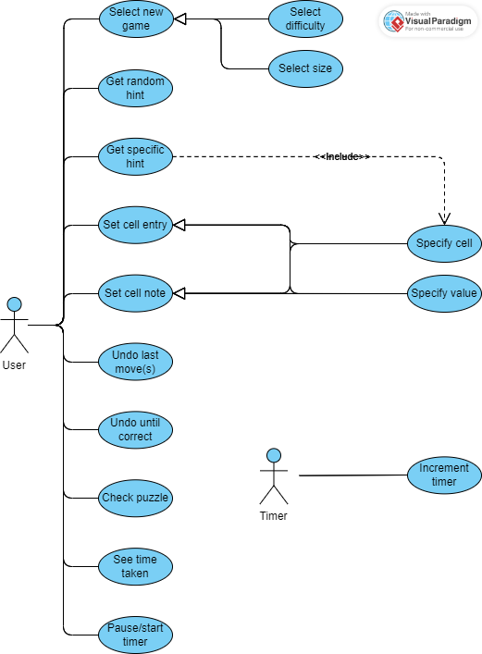
Class exercise / homework
A
Write a use case scenario for the use case indicated for your team
B
Elements of a Use Case
Depending on how in depth and complex you want or need to get, use cases describe a combination of the following elements:
Actor – anyone or anything that performs a behavior (who is using the system)
Stakeholder – someone or something with vested interests in the behavior of the system under discussion (SUD)
Primary Actor – stakeholder who initiates an interaction with the system to achieve a goal
Preconditions – what must be true or happen before and after the use case runs.
Triggers – this is the event that causes the use case to be initiated.
Main success scenarios [Basic Flow] – use case in which nothing goes wrong.
Alternative paths [Alternative Flow] – these paths are a variation on the main theme. These exceptions are what happen when things go wrong at the system level.
How To Write a Use Case
Write the steps in a use case in an easy-to-understand narrative. Kenworthy (1997) outlines the following steps:
Identify who is going to be using the website.
Pick one of those users.
Define what that user wants to do on the site. Each thing the use does on the site becomes a use case.
For each use case, decide on the normal course of events when that user is using the site.
Describe the basic course in the description for the use case. Describe it in terms of what the user does and what the system does in response that the user should be aware of.
When the basic course is described, consider alternate courses of events and add those to "extend" the use case.
Look for commonalities among the use cases. Extract these and note them as common course use cases.
Repeat the steps 2 through 7 for all other users.
C
D
E
F

Slide 4
Review of homework
Write a use case scenario for the use case(s) assigned to your team
Use Case Scenarios
A fully documented project would be a collection of all the documents from the individual interaction scenarios
The level of detail should be enough to hand the document off to be programmed (in terms of logic)
Preconditions set up the interaction, not define what a user can and cannot do during an interaction. E.g.:
User enters a value into a grid location, vs.
User enters a correct value or legal value into a grid location
Use Case Diagrams
Ovals/nodes should represent tasks, not user input or actions.
Tasks are what the user wants to accomplish, for example: enter a value, enter a note, undo last entry, etc.
These diagrams are not about how the user accomplishes these tasks(input), for example: click on a number to select entry value followed by clicking on a grid location to place entry.
Task: Enter a value
Input: Select a value, Select a grid location
(Changing a GUI doesn’t change the task)

Slide 5
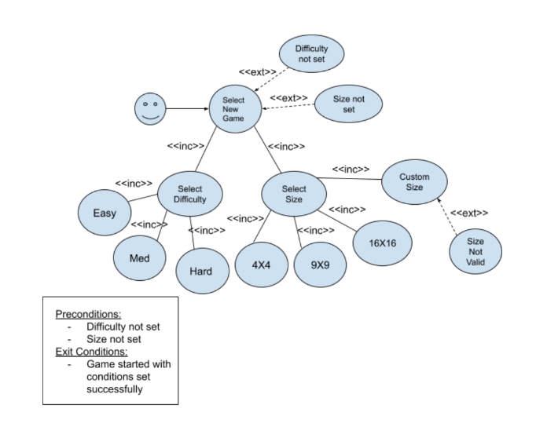
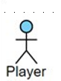
Team A: Select New Game
Select new game
Select difficulty
Select size
<<extends>>
<<extends>>
Difficulty not set
Size not set
Size not valid
Ovals/nodes should represent tasks, not user input or actions.
Tasks are what the user wants to accomplish, for example: enter a value, enter a note, undo last entry, etc.
These diagrams are not about how the user accomplishes these tasks(input), for example: click on a number to select entry value followed by clicking on a grid location to place entry.

Slide 6
Team A: Select New Game
Select new game
Scenario Title: Select New Game
Actor: Puzzle solver
Stakeholder: Company hosting puzzle app
Preconditions:
App is installed and first instantiated or
App is running and actor wants to start a new game or
Puzzle has been solve and a new game is to be started
Triggers:
Program flow initiates
Actor initiates
Main success scenarios: [Basic Flow] Actor specifies games size and difficulty and new puzzle appears and is ready for use
Alternative paths: [Alternative Flow] Incomplete specification of new puzzle’s parameters
Select difficulty
Select size
<<extends>>
<<extends>>
Difficulty not set
Size not set
Size not valid

Slide 7
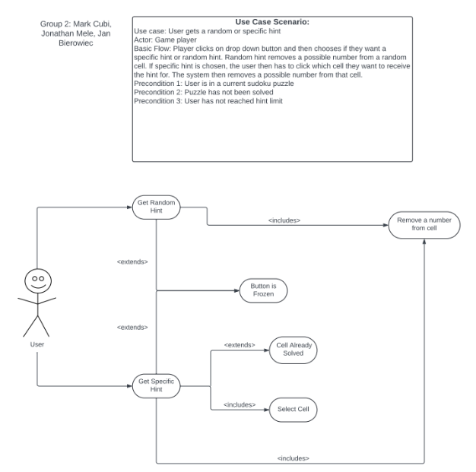
Team B: Get Random and Specific Hints
Scenario Title: Get Random Hint
Actor: Puzzle solver
Stakeholder: Company hosting puzzle app
Preconditions:
Actor has started an unfinished puzzle
Triggers:
Actor initiates
Main success scenarios: [Basic Flow]
Puzzle is re-displayed with a randomly chosen error corrected, or (if no errors)
Puzzle is re-displayed with a randomly chosen empty location filled in
Alternative paths: [Alternative Flow]
Scenario Title: Get Specific Hint
Actor: Puzzle solver
Stakeholder: Company hosting puzzle app
Preconditions:
Actor has started an unfinished puzzle
Triggers:
Actor initiates
Main success scenarios: [Basic Flow]
Actor selects a non-given cell to be filled in with a correct answer
Puzzle is re-displayed with cell indicated correctly filled in
Alternative paths: [Alternative Flow]
Actor selects a ‘given’ cell

Slide 8
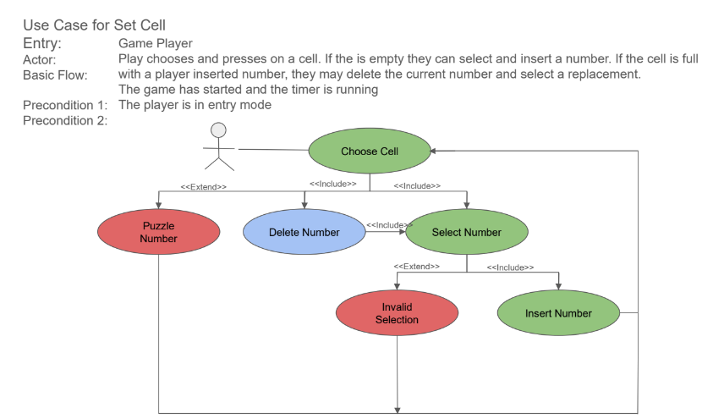
Team C: Set Cell
Scenario Title: Set Cell Value
Actor: Puzzle solver
Stakeholder: Company hosting puzzle app
Preconditions:
Actor has started an unfinished puzzle
Triggers:
Puzzle app is in value entry mode
Main success scenarios: [Basic Flow]
Actor selects a non-given cell to fill in (including overriding)
Actor selects a value to be put in chosen cell
Alternative paths: [Alternative Flow]
Actor selects a ‘given’ cell
Actor selects an illegal value

Slide 9
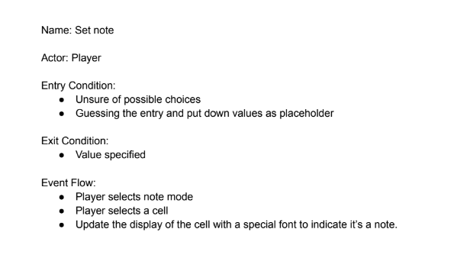
Team D: Set Note
Scenario Title: Set Cell Note
Actor: Puzzle solver
Stakeholder: Company hosting puzzle app
Preconditions:
Actor has started an unfinished puzzle
Triggers:
Puzzle app is in note entry mode
Main success scenarios: [Basic Flow]
Actor selects a non-given cell to fill in (including overriding)
Actor selects a note value to be put in chosen cell
Selecting an existing value will erase it
Selecting a new value will add it
Alternative paths: [Alternative Flow]
Actor selects a ‘given’ cell
Actor selects an illegal value

Slide 10
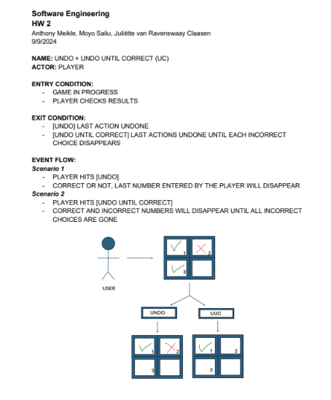
Team E: Undo and Undo Until Correct
Scenario Title: Undo
Actor: Puzzle solver
Stakeholder: Company hosting puzzle app
Preconditions:
Actor has started an unfinished puzzle
Triggers:
Actor initiates
Main success scenarios: [Basic Flow]
Puzzle is re-displayed with cell last filled in put back to it’s previous value
Works for both value and note entries
Alternative paths: [Alternative Flow]
Puzzle has no actor entered values or notes
Scenario Title: Undo Until Correct
Actor: Puzzle solver
Stakeholder: Company hosting puzzle app
Preconditions:
Actor has started an unfinished puzzle
Triggers:
Actor initiates
Main success scenarios: [Basic Flow]
Puzzle is re-displayed with all moves from most recent to last recent undone until whole puzzle is error free
Note: “incorrect” note entries are not checked for
Alternative paths: [Alternative Flow]
Puzzle has no actor entered values or notes
Puzzle has no errors

Slide 11
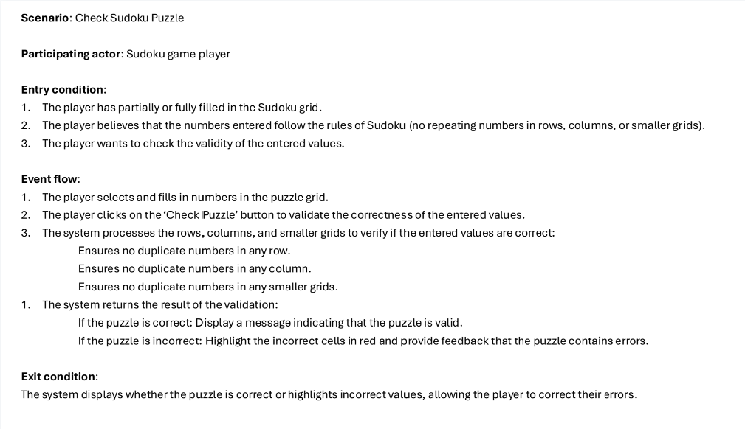
Team F: Check Sudoku Puzzle
Scenario Title: Check Sudoku Puzzle for Correctness
Actor: Puzzle solver
Stakeholder: Company hosting puzzle app
Preconditions:
Actor has started an unfinished puzzle
Triggers:
Actor initiates
Main success scenarios: [Basic Flow]
Puzzle is re-displayed with any errors indicated
Only works for value entries, not note entries
All user entered cell values are checked against the ‘ground truth’
Alternative paths: [Alternative Flow]
There are no errors

Slide 12
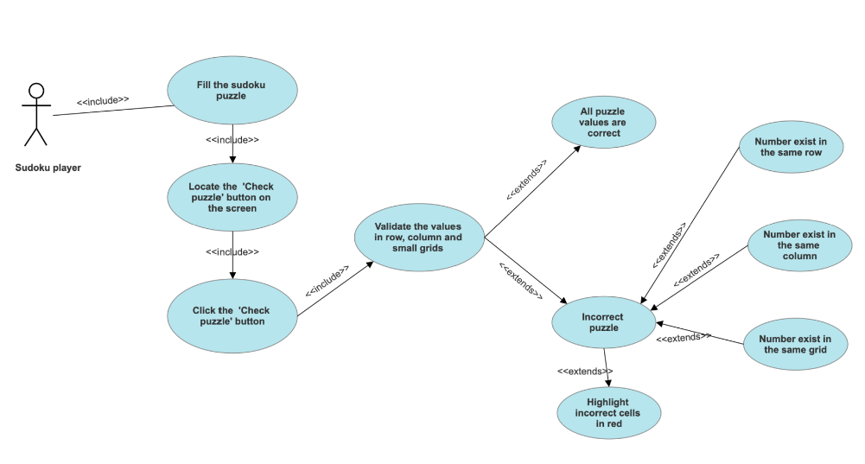
Team F: Check Sudoku Puzzle
Ovals/nodes should represent tasks, not user input or actions.
Tasks are what the user wants to accomplish, for example: enter a value, enter a note, undo last entry, etc.
These diagrams are not about how the user accomplishes these tasks(input), for example: click on a number to select entry value followed by clicking on a grid location to place entry.

Slide 13
Not assigned: See, pause, resume timer
Scenario Title: See, Pause, Resume Timer
Actor: Puzzle solver
Stakeholder: Company hosting puzzle app
Preconditions:
Actor has started unfinished puzzle
Actor has finished a puzzle
Triggers:
Actor initiates
Main success scenarios: [Basic Flow]
Amount of time taken so far to solve an incomplete puzzle is displayed
Actor can pause the timer
Time count and display are resumed
Actor initiates
App initiates upon actor using any current puzzle’s controls
Alternative paths: [Alternative Flow]
Puzzle app is put in background (is not in active use)

Slide 14
Not assigned: increment timer
Scenario Title: Increment timer
Actor: Application time event handler
Stakeholder: Company hosting puzzle app
Preconditions:
App user is actively solving an unfinished puzzle
Triggers:
Puzzle begins
One second has elapsed since last increment
Main success scenarios: [Basic Flow]
Amount of time taken so far to solve an incomplete puzzle is displayed
Alternative paths: [Alternative Flow]
Puzzle solving has been put on pause
Puzzle has been completed

Slide 15
Use Case Diagram (high-level)
Also available on Blackboard
Details for each task could be captured on this use case diagram or on individual diagrams

Slide 16
Requirement gathering and specification comparison
IMHO
Metric | Use Case Scenario | Use Case Diagram | Storyboard | Rapid prototype
Customer understanding | + | - - | + + | ++
Detail | + + | - | + | ++
Programmer understanding | + | + | ++ | ++
Test specification | + | ++ | - | +
Port to implementation | - | - | + | ++
Ease of creation | + + | + | - * | -- **
“Look and Feel” | - | -- | + | ++
* If storyboards are created in a Software Development Kit (SDK), then the effort can be re-used in implementation, saving valuable time
** If prototypes are created with code reuse in mind, they may save in development time

Slide 17
Process Models

Slide 18
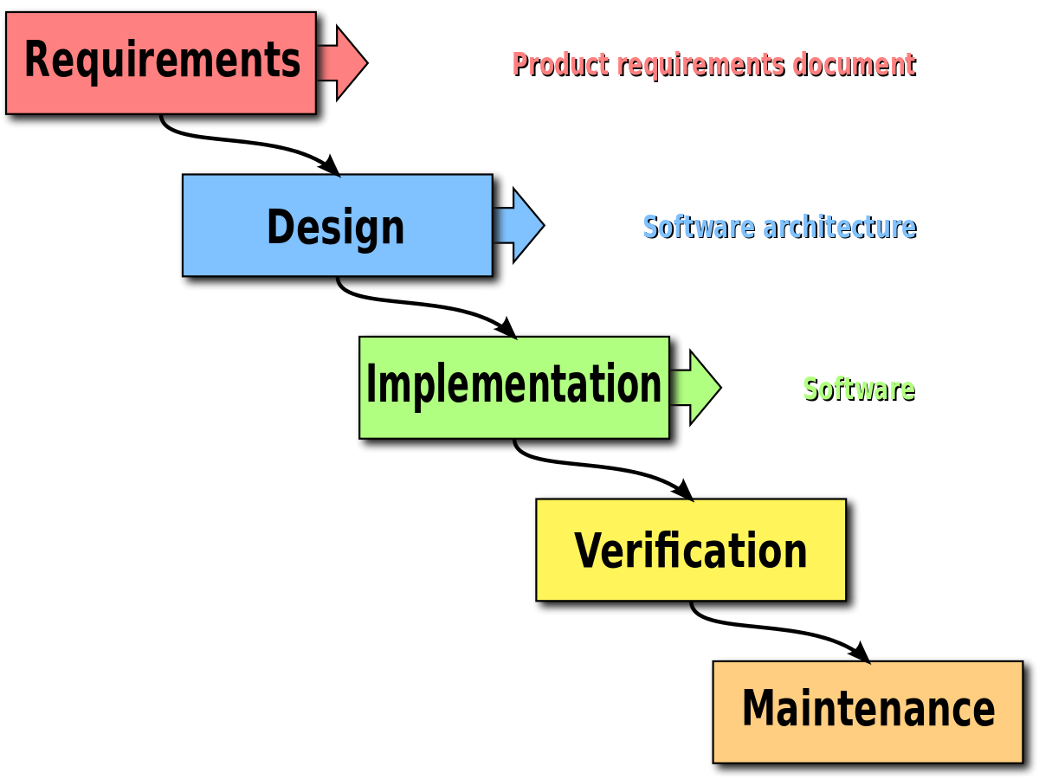
Waterfall Model
Pros
Time spent early in a SDLC can reduce costs at later stages (e.g. bug fix later can be 50-200 times more expensive)
More emphasis on complete design and documentation making it easier for adding or changing team members
Easy to understand and translates easily to milestones (project management)
Best when there are strict requirements, fixed scope, and the product is firm and stable and its technology is clearly understood.
Cons
Clients may not fully understand their requirements before they see working software
Designers may not be aware of future difficulties
“Some organisations, such as the United States Department of Defense, now have a stated preference against waterfall-type methodologies, starting with MIL-STD-498, which encourages evolutionary acquisition and Iterative and Incremental Development.[15]”
Material from or adapted from Wikipedia

Slide 19
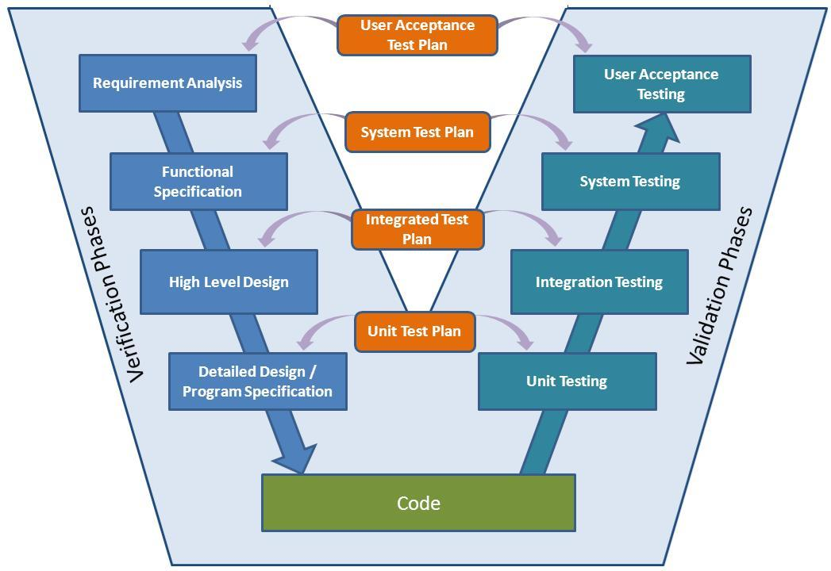
Pros
Adds explicit testing to the waterfall model (both test design and implementation)
Has been adopted by the medical device industry
V-Model
Cons
All testing is after coding
Most of the pitfalls of the waterfall model
Overly simplified
Attribution: http://www.softwaretestingstudio.com/v-model-software-development/ and https://en.wikipedia.org/wiki/V-Model_(software_development)

Slide 20
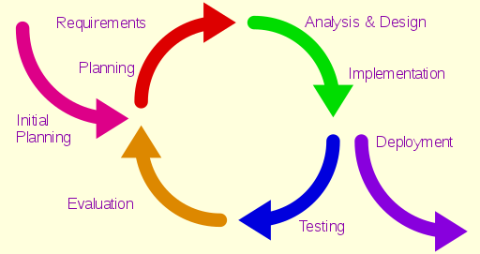
Iterative Model
Pros
Best when a product’s functionality can be rolled out over time
Involves frequent feedback from customers and/or market
Faster (initial) time to market
Cons
Can lead to legacy code that is hard to continue working with
Can lead to code full of patches
By Aflafla1 - Iterative development model V2.jpg , User:Westerhoff, CC0, https://commons.wikimedia.org/w/index.php?curid=34159246

Slide 21
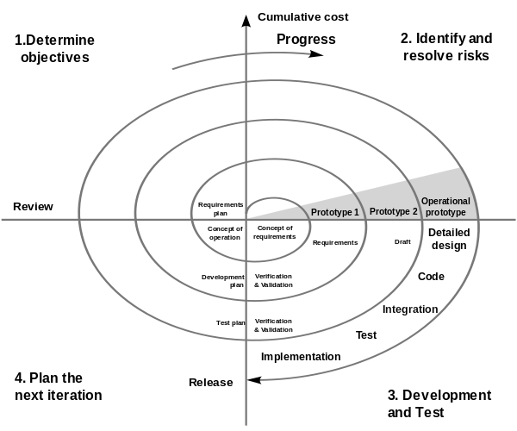
Spiral Model
Pros
Like the iterative model but with a strong philosophical background to perform risk analysis for each iteration
Cons
Using the diagram without understanding the underlying philosophy can lead to all the pitfalls of the iterative model, i.e. so called “hazardous spiral look-alike” processes
Conny derivative work: Spiral_model_(Boehm,_1988).png: Marctroy derivative work: Conan (talk) - File:Spiralmodel_nach_Boehm.png, Spiral_model_(Boehm,_1988).png

Slide 22
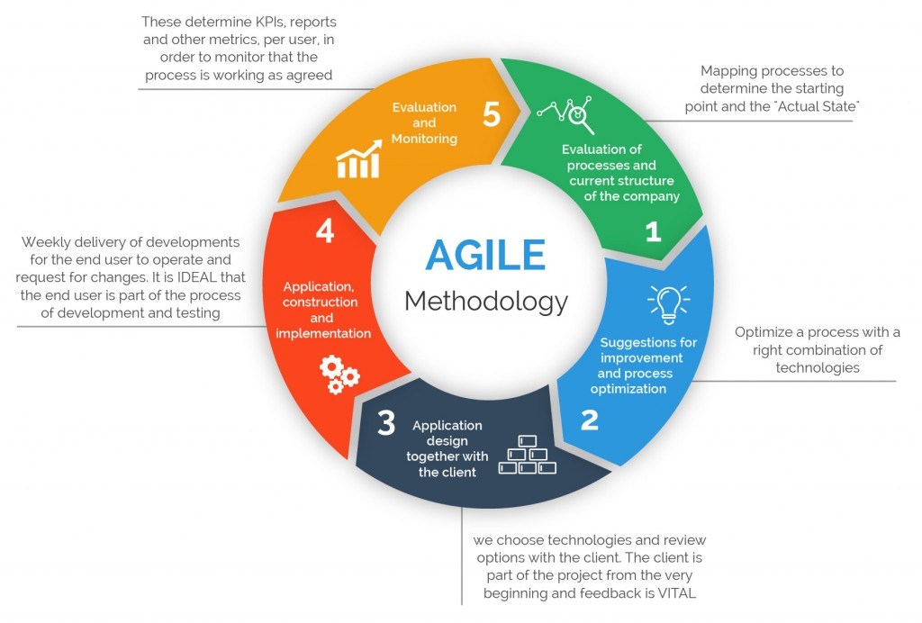
Agile
Pros
Very customer oriented
Can help to very quickly launch product iterations
Allows for change
Cons
Desired degree of customer involvement can be (too) high
May lead to frequent refactoring
Potentially inefficient in large organizations
Criticized as being a management fad
Attribution: https://www.360logica.com/blog/the-importance-of-different-agile-methodologies-included-in-agile-manifesto/
https://en.wikipedia.org/wiki/Agile_software_development#Criticism
https://www.seguetech.com/waterfall-vs-agile-methodology/

Slide 23
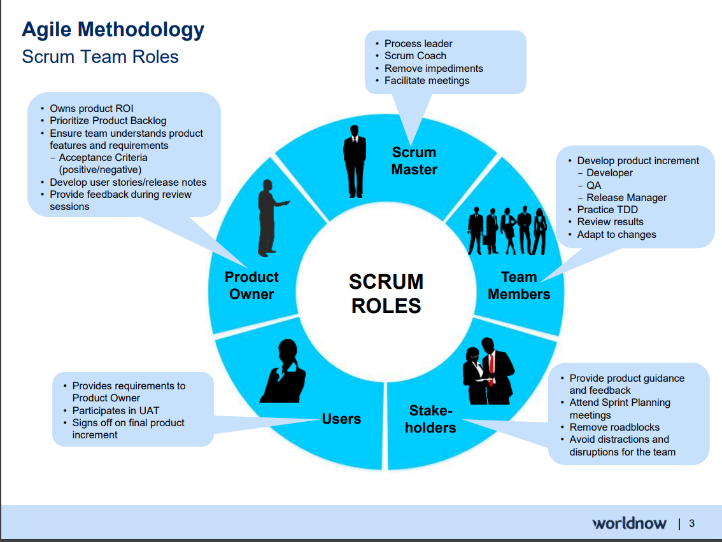
Attribution: https://www.slideshare.net/SandyLee9/agile-methodology-assessment-73719466

Slide 24
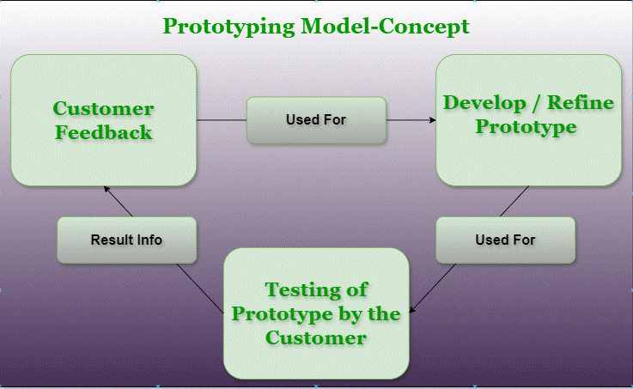
Prototype
Pros
Very customer oriented
Helpful when design decisions are not well known
Can produce reusable code for final implementation
Cons
Can overwhelm developers if customers can’t make decisions
The prototype may not consider technical feasibility and scalability issues that can arise during the final product development.
Reusing prototype code may lead to a sub-optimal solution
Attribution: https://www.geeksforgeeks.org/software-engineering-prototyping-model/
Sudoku example
Research example

Slide 25
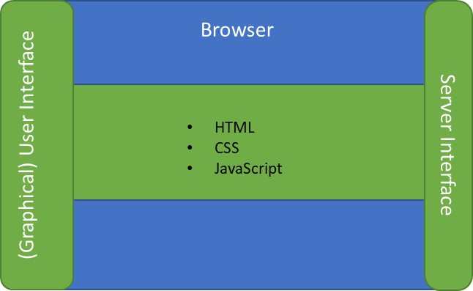
Sudoku – reference Architecture
Database
Internet
Graphical User Interface
(view)
JSON encoder/decoder
URL encoder
URL parser
State save/load
Browser
Server
JSON encoder/decoder
Sudoku engine
(controller)
HTML
CSS
JavaScript
http request
URL
JSON
Django
SQLite
Python
Sudoku representaton
(model)
http response
JSON

Slide 26
Other requirements
The following slides are from check lists found in another source from our book, but Chapter 6 in our book is a good reference for these and others.

Slide 27
Requirements
Specific Functional Requirements
Are all the tasks the user wants to perform specified?
Tasks versus input
Is the data used in each task and the data resulting from each task specified?
Are all the inputs to the system specified, including their source, accuracy, range of values, and frequency?
Are all the outputs from the system specified, including their destination, accuracy, range of values, frequency, and format?
Are all the external communication interfaces specified, including handshaking, error-checking, and communication protocols?
Task: Enter a value
Input: Select a value, Select a grid location
(Changing a GUI doesn’t change the task)
But only at the end points
Medical example - Check data entered against known ranges (note that these are not the same as “normal” ranges):
Heart rate: 0 <= HR <= 250
Respiratory rate: 0 <= RR < 100
Blood oxygen: 0 <= SpO2 < 100
Not yet. So far, we have only covered user requirements, not technical requirements. We will get to these later.
From: Code Complete: A Practical Handbook of Software Construction
Steve McConnell
Second edition
McConnell Microsoft Press 2004
ISBN 0-7356-1967-0

Slide 28
Requirements
Specific Nonfunctional (Quality) Requirements
Is the expected response time, from the user's point of view, specified for all necessary operations, including:
processing time, data transfer rate, and system throughput?
Is the level of security specified?
Is the reliability specified, including the consequences of software failure, the vital information that needs to be protected from failure, and the strategy for error detection and recovery?
Is the maintainability of the system specified, including its ability to adapt to changes in specific functionality, changes in the operating environment, and changes in its interfaces with other software?
Is the definition of success included? Of failure?
Let’s do this now!
Let’s discuss, but mostly not too critical for our project.
Will consider more fully when developing the system architecture.
From: Code Complete: A Practical Handbook of Software Construction
Steve McConnell
Second edition
McConnell Microsoft Press 2004
ISBN 0-7356-1967-0

Slide 29
Requirements
Requirements Quality
Are the requirements written in the user's language?
Do the users think so?
Does each requirement avoid conflicts with other requirements?
Are acceptable tradeoffs between competing attributes specified—for example, between robustness and correctness?
Do the requirements avoid specifying the design?
Are the requirements at a fairly consistent level of detail? Should any requirement be specified in more detail? Should any requirement be specified in less detail?
Are the requirements clear enough to be turned over to an independent group for construction and still be understood? Do the developers think so?
Is each requirement testable?
The storyboards are.
Will be done as part of project planning.
Yes, except for me specifying it will run in a browser with server-side processing.
Not yet.
We believe so but have not yet created the testing specification.
From: Code Complete: A Practical Handbook of Software Construction
Steve McConnell
Second edition
McConnell Microsoft Press 2004
ISBN 0-7356-1967-0

Slide 30
Requirements
Requirements Completeness
Where information isn't available before development begins, are the areas of incompleteness specified?
Are the requirements complete in the sense that if the product satisfies every requirement, it will be acceptable?
Partially (see next slide), but there is still much design to complete before development begins.
So far yes, but there are still many requirements to develop.
From: Code Complete: A Practical Handbook of Software Construction
Steve McConnell
Second edition
McConnell Microsoft Press 2004
ISBN 0-7356-1967-0

Slide 31
Missing and/or unclear requirements
What happens when all cells are filled in?
How do you erase a note value?
Are notes sorted?
Are there times for “Are you sure” messages to the player? E.g., Selecting new game while still in an unfinished game.
Can you edit existing library puzzles in ‘create’ mode?
How does difficulty level get assigned? To randomly generated puzzles? To user created puzzles?
Do we need a message area to communicate with a player and/or creator?

Slide 32
Deriving components (example): use case driven design
Lead into class exercise 1

Slide 33
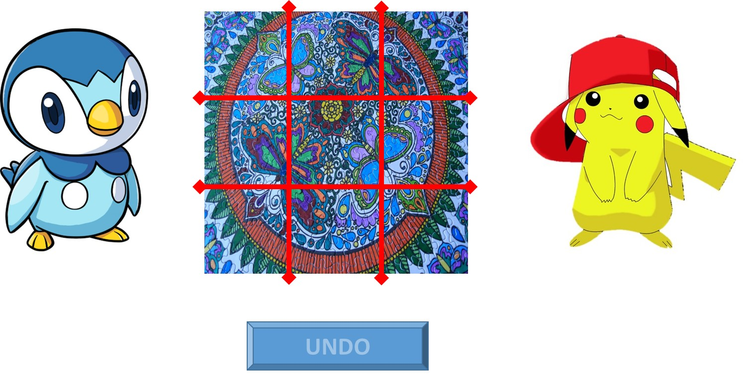
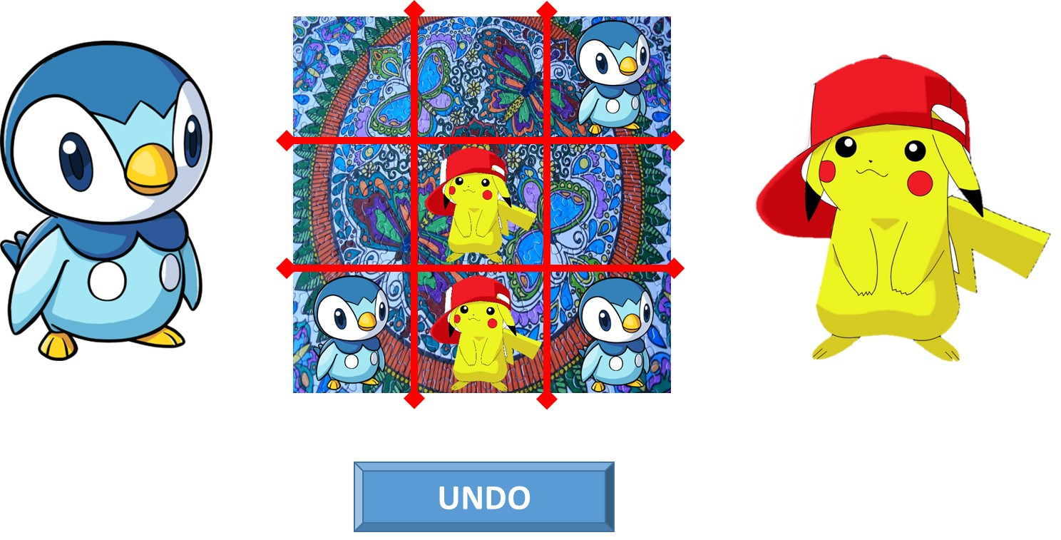
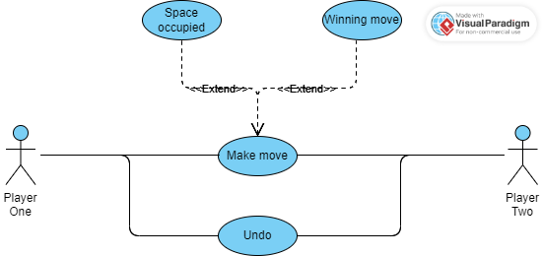
Deriving components (example): use case driven design

Slide 34
Deriving components (example): use case driven design
Game Begins:
Draw board
Draw players
Create “Undo” button, faded out
Set turn to left-side player
Draw lights
Make a move - Location selected:
If location selected not already occupied
Put current player’s representation at location selected and record move
If move wins game
Show winning path
Prompt for another game …
Restart or exit
Make “Undo” not faded out
Change turn to other player
If location already selected notify player to select an empty location
Undo selected:
Remove last move from board
Change turn back to previous player

Slide 35
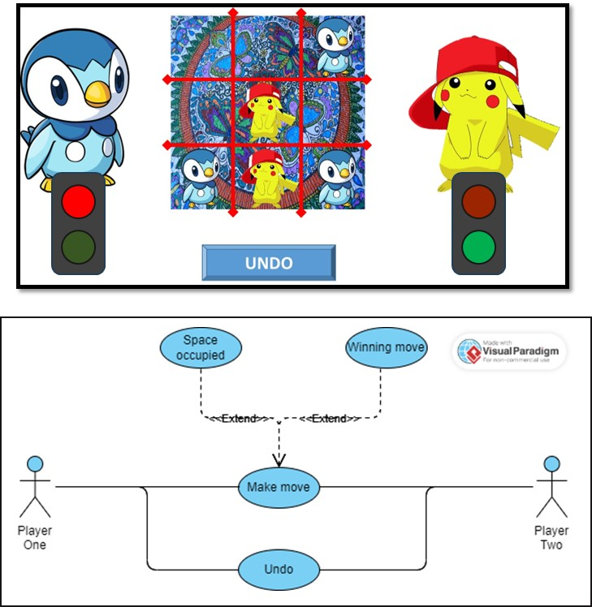
Deriving components (example): use case driven design
Game Begins:
Draw board
Draw players
Create “Undo” button, faded out
Set turn to left-side player
Draw lights
Location selected:
If location selected not already occupied
Put current player’s representation at location selected and record move
If move wins game
Show winning path
Prompt for another game …
Restart or exit
Make “Undo” not faded out
Change turn to other player
If location already selected notify player to select an empty location
Undo selected:
Remove last move from board
Change turn back to previous player
Graphical User Interface
(GUI)
Handle user input
Update user display
Game representation
(Data structures/classes)
Turn
Board
Move history
Game Engine
Legal move?
Make move
Winning move?

Slide 36
Deriving design information
For the task assigned to your group:
Trace through and record all steps you can think of that a program must go through to complete the task (both for desired outcomes and exceptions)
Keep track of any incompletely specified requirements/questions that come up
Class exercise
Then as a full class:
List all
Cluster

Slide 37
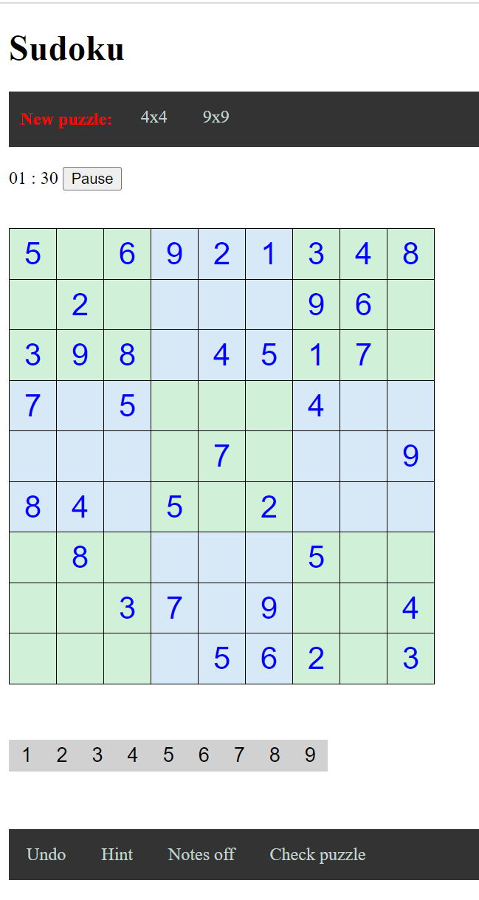
Use Case Diagram (high-level)
F
A
Team A
Vanessa
Aryan
Jan Bieniek
Team D
Jason
Robert
Nika
A
B
B
Team B
Jan Bierowiec
Mark
Jonathan
Team E
Moyo
Juliette
Tone
C
C
E
D
Team C
Michael
Danny
Mintesnot
Team F
Prarthana
Gurpreet
Akash
E
E

Slide 38
Component Diagrams
Shows various components in a system and their dependencies, interfaces
Explains the structure of a system
Usually a physical collection of classes
Similar to a Package Diagram in that both are used to group elements into logical structures
With Component Diagrams all of the model elements are private with a public interface whereas Package diagrams only display public items.

Slide 39
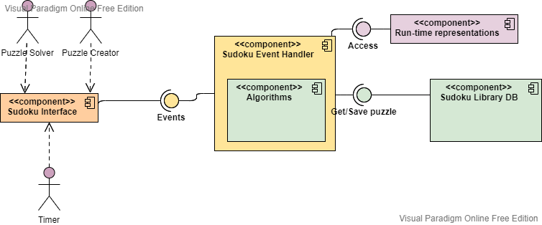
Next steps
Steps
Requirements analysis
Customer supplies high-level specs
Story boards created for key aspects
Further clarification of customer requirements using use-case diagrams
Rapid prototype
Identify high-level components
Group high-level components
Next steps
Design analysis
Sequence diagrams

Slide 40
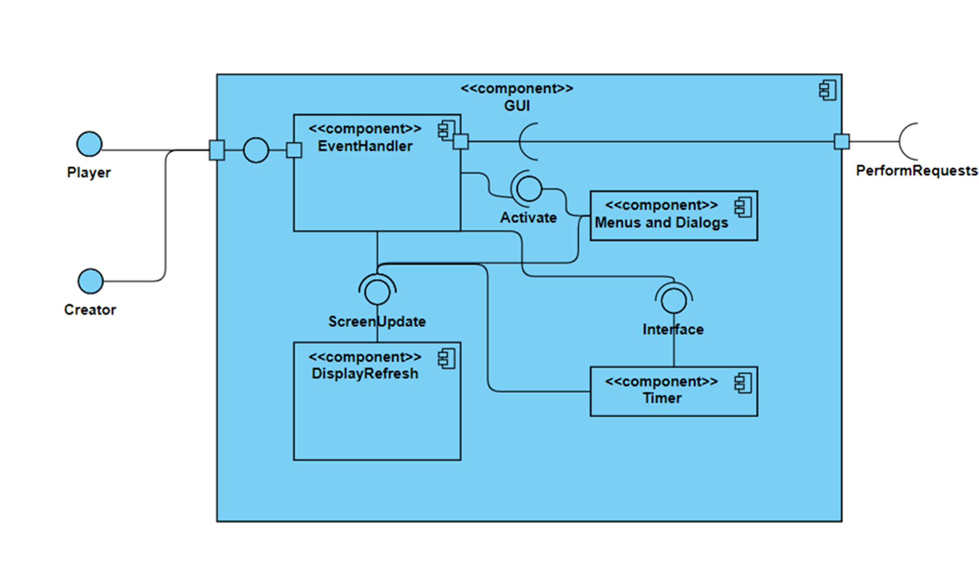
Component Diagram

Slide 41
Interaction Diagrams
Interaction diagrams are dynamic -- they describe how objects collaborate
A Sequence Diagram:
Indicates what messages (function calls, method instantiations) are sent and when
Time progresses from top to bottom
Components involved are listed left to right
Messages are sent left to right among components in sequence

Slide 42
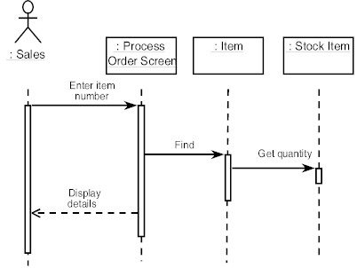
Sequence Diagram Format
Actor from
Use Case
Objects
1
Activation
2
3
4
Lifeline
Calls = Solid Lines
Returns = Dashed Lines

Slide 43
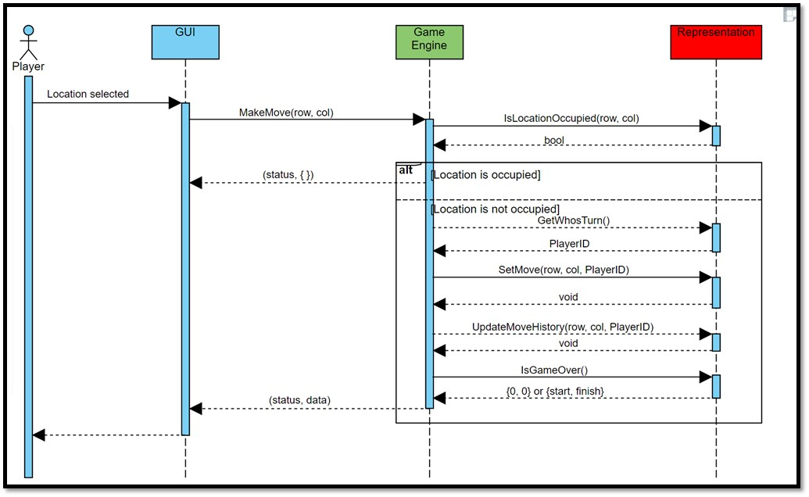
Deriving components (example): use case driven design
Game Begins:
Draw board
Draw players
Create “Undo” button, faded out
Set turn to left-side player
Draw lights
Location selected:
If location selected not already occupied
Put current player’s representation at location selected
If move wins game
Show winning path
Prompt for another game …
Restart or exit
Make “Undo” not faded out
Change turn to other player
If location already selected notify player to select an empty location
Undo selected:
Remove last move from board
Change turn back to previous player
Graphical User Interface
(GUI)
Game representation
(Data structures/classes)
Turn
Board
Move history
Game Engine
Legal move?
Make move
Winning move?

Slide 44
Project management tools
Purpose
Planning
Fixed deadline
Fixed deliverable
Progress tracking
User tracking
Scheduling
Issue tracking
Billing
Timecard generation
Communication
Examples
Zoho
Excel
Mindmap extensions,
Microsoft Project, ..
https://en.wikipedia.org/w/index.php?curid=659967
https://skillforge.com/microsoft-project-formatting-gantt-chart-summary-task/

Slide 45
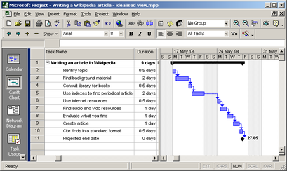
Project management tools
https://skillforge.com/microsoft-project-formatting-gantt-chart-summary-task/

Slide 46
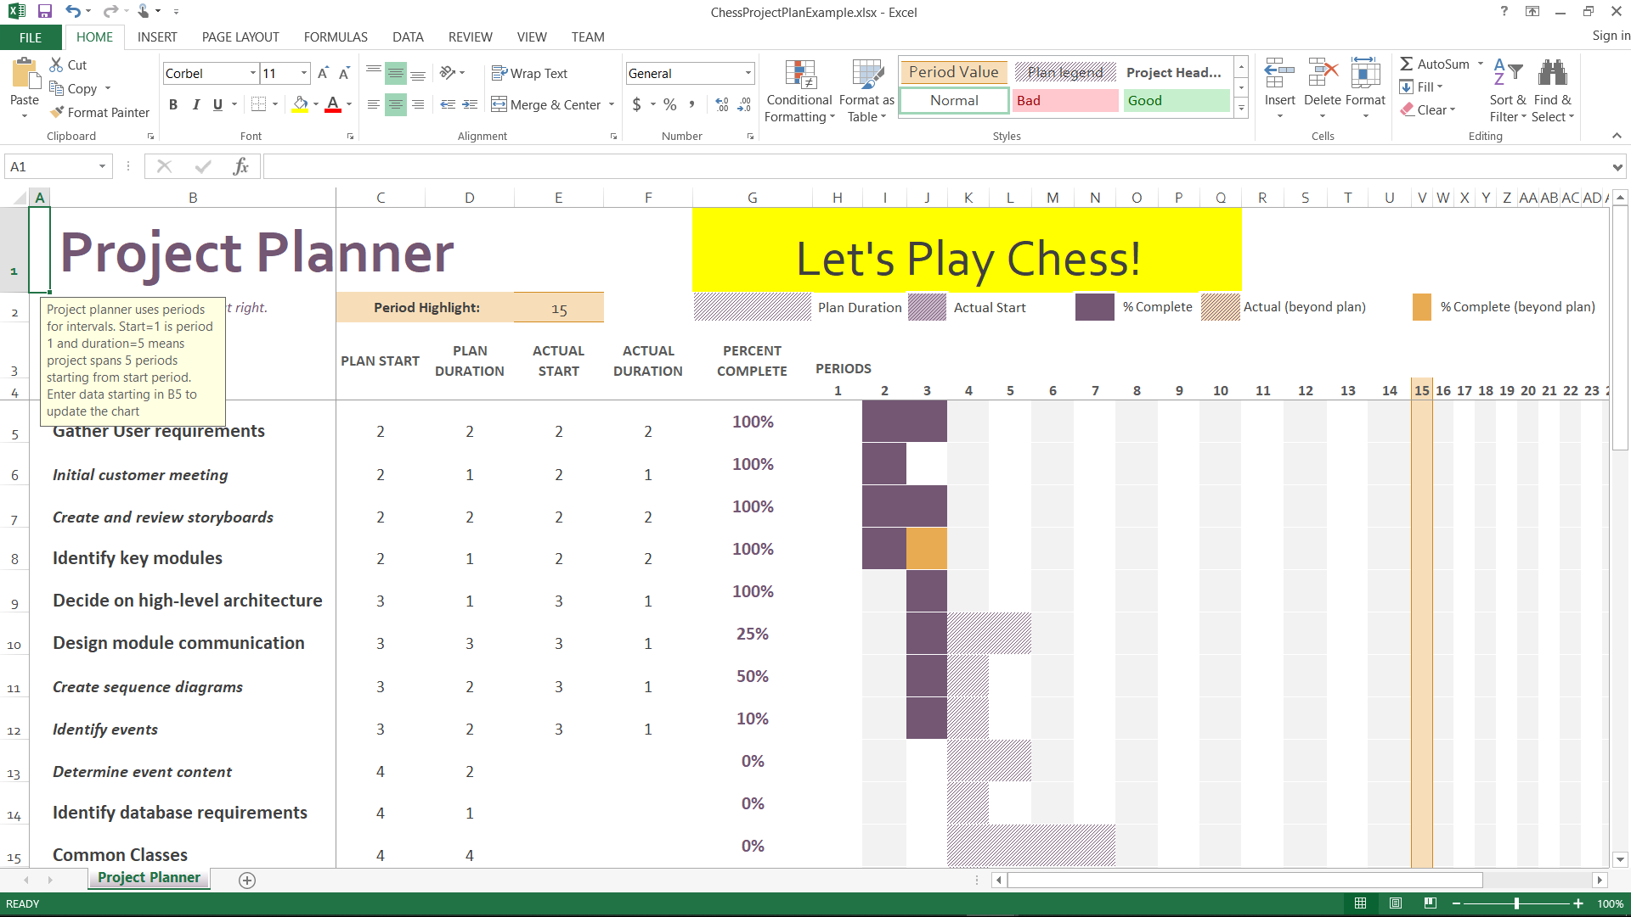
Project management tools

Slide 47
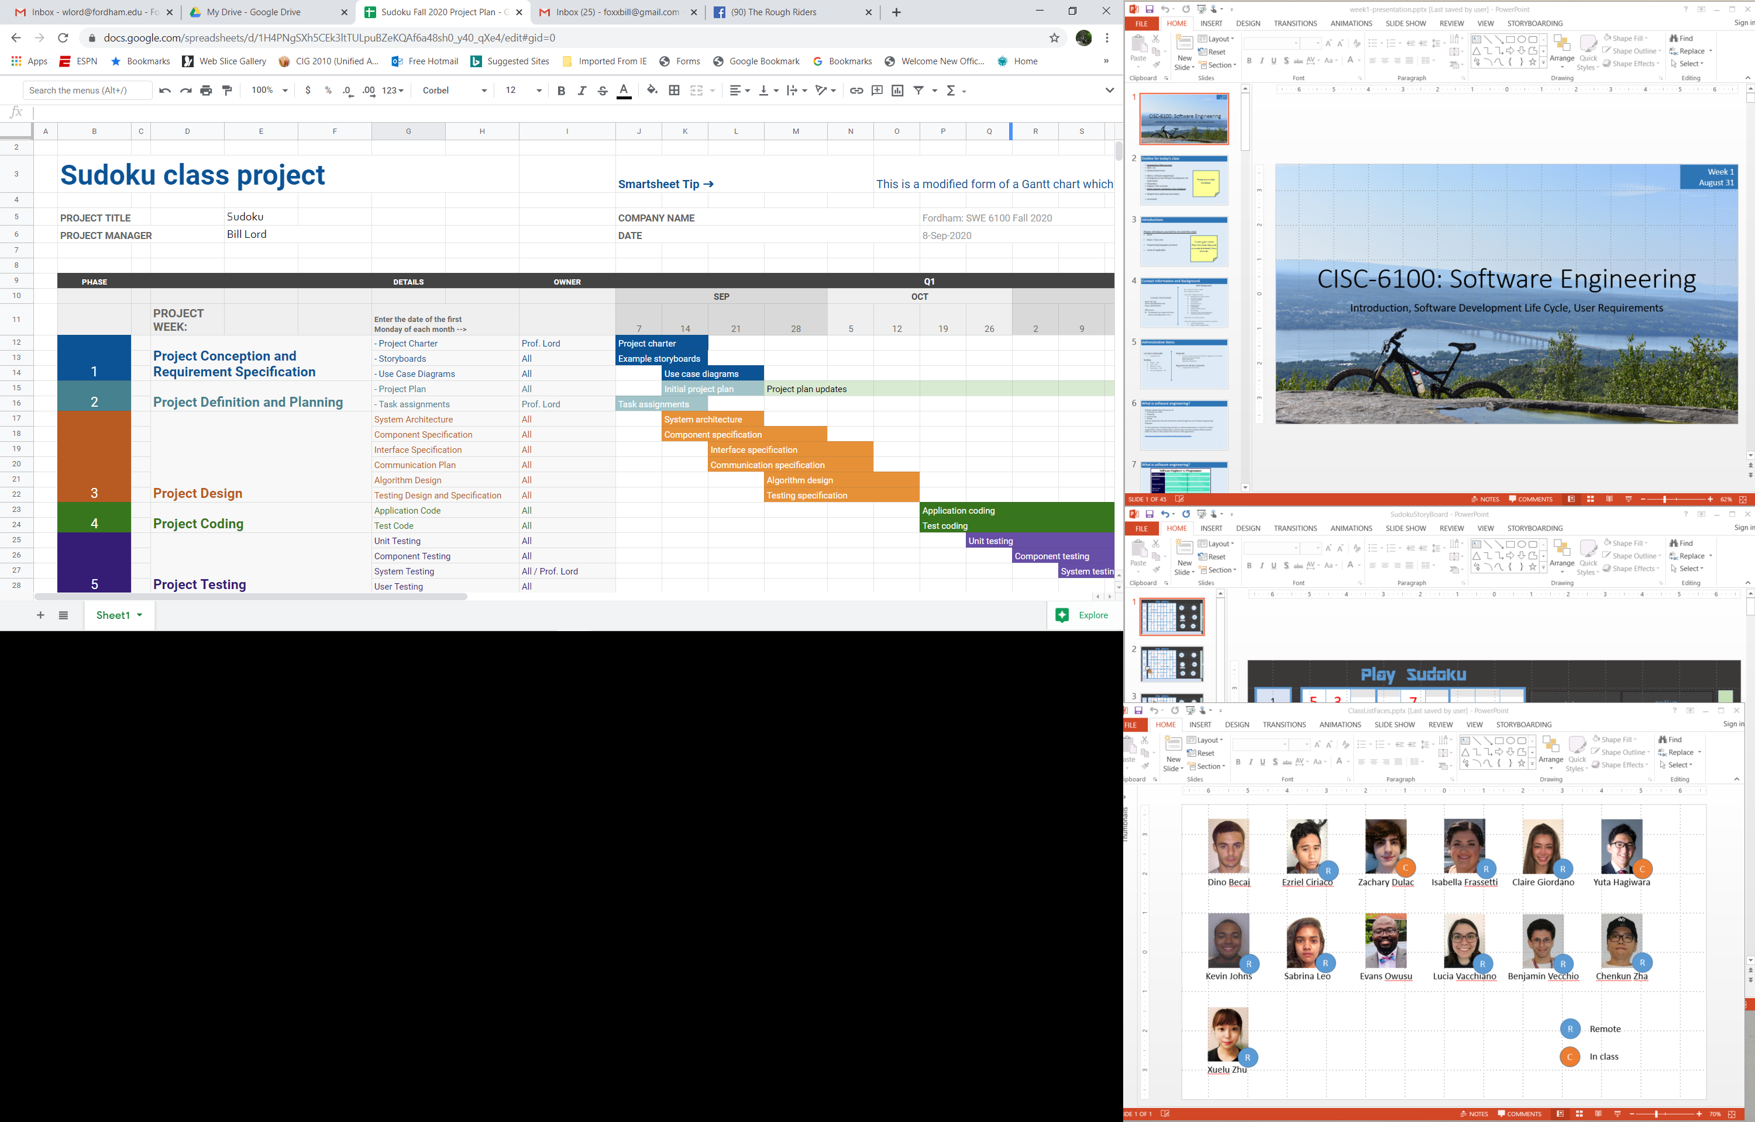
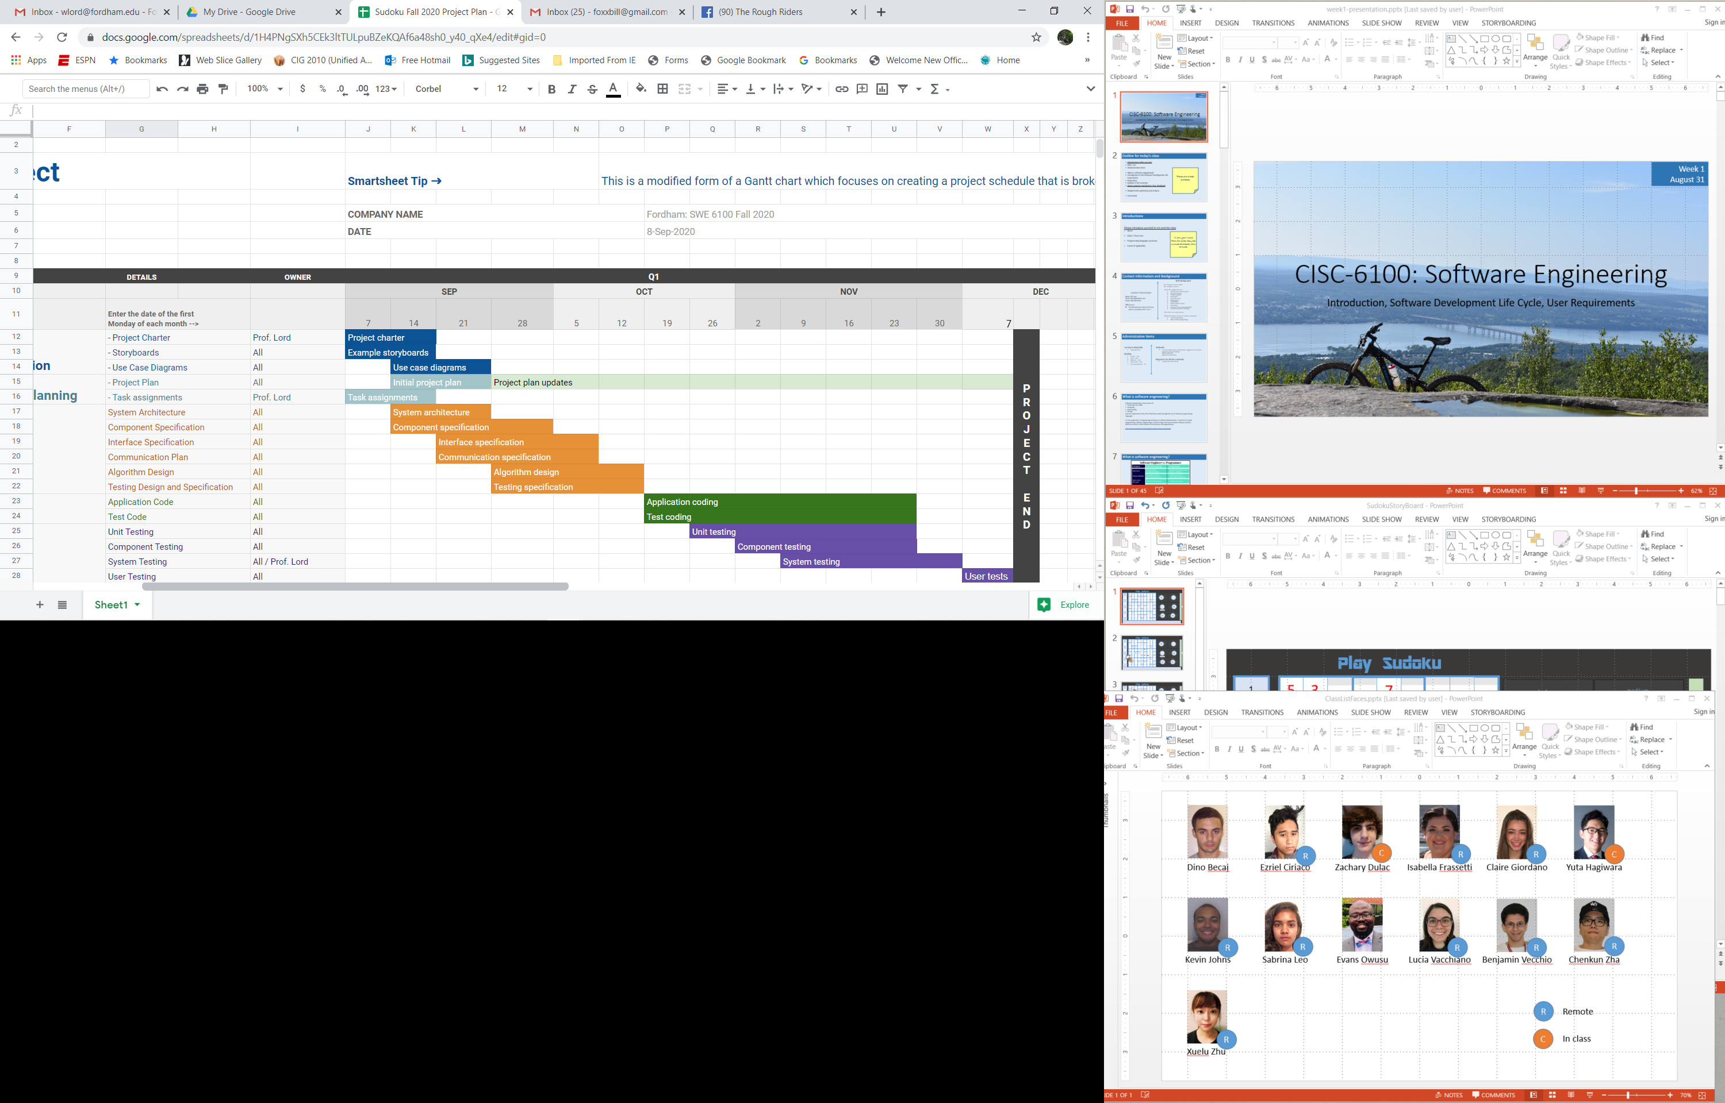
Project management tools

Slide 48
Homework: To be done individually and then again with AI
If desired, choose a new name for your team!
Create a UML sequence diagram for:
Vanessa, Jason: Set cell entry
Aryan, Robert: Undo last move
Jan Bierowiec, Nika: Set cell note
Jan Bieniek, Moyo: Check puzzle
Mark, Juliette: Pause/Start timer
Jonathan, Tone: Get random hint
Michael, Prarthana: Select new game
Danny, Gurpreet: Get specific hint
Mintesnot, Akash: Undo until correct
Start a project plan using a tool of your choice. Populate it with:
Gathering user requirements
Generating technical requirements
Documenting testing specification
Implementation
Testing

Slide 49
Homework: To be done individually and then again with AI
For the use of AI in doing/helping with your homework, for the sequence diagram only, check one of the following:
The AI could take my job
The AI and I would make a great team
Keep trying AI, my job is secure!
In 1-5 sentences explain your answer above

Slide 50
Extras

Slide 51
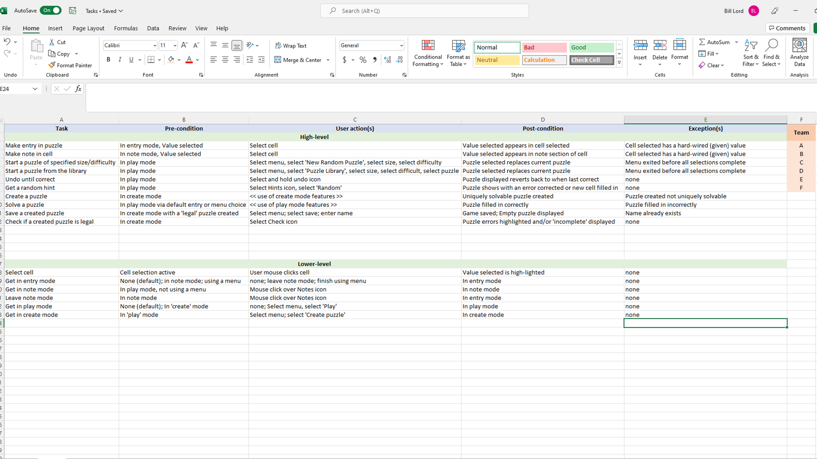

Slide 52
Annotated System Diagram
REST
JSON
REST
JSON
Web Server
MongoDB
Web client
JavaScript
CSS
HTML
Web Server
C++

